Slide 1
BizTalk Mapping Patterns and Best Practices
Sandro Pereira
Senior Software Developer
Microsoft Integration MVP
Bouvet BizTalk Innovation Day 2013

Slide 2


Sandro Pereira
Senior Software Developer at DevScope
Microsoft Integration MVP since 2011
Writer of numerous articles for Portuguese eMagazine “Programar”
Author “Sandro Pereira BizTalk Blog” http://sandroaspbiztalkblog.wordpress.com
Member of “BizTalkAdminsblogging.com” and “BizTalk Brasil” community
Member NetPonto community
MSDN BizTalk Forums Moderator
TechNet Wiki author (Wiki Ninja)
TechNet Gallery, Code Gallery and CodePlex contributor
Public speaker
Technical Reviewer PACKT Publishing
BizTalk Server 2010 Cookbook (April 2012)

Slide 3
Agenda
BizTalk Mapper Basics
How BizTalk Mapper Works
Best Practices
Common mapper problems and solutions

Slide 4
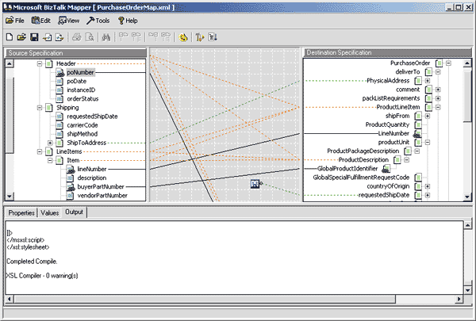
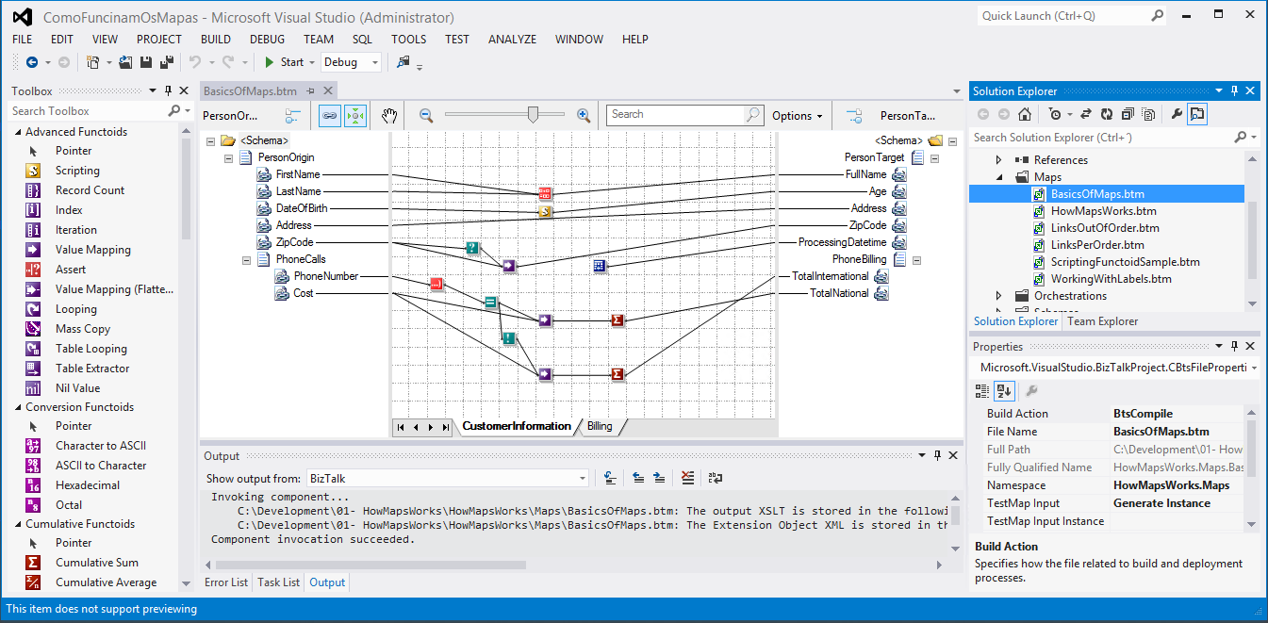

Do you recognize this?

Slide 5
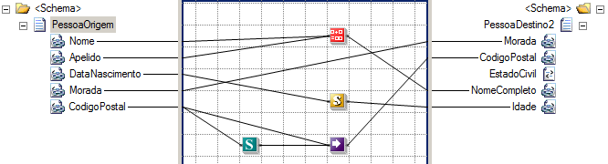
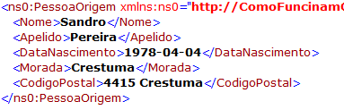
Transformation types
Syntax
Semantics
CSV → XML
←→ Bidirectional
Schema → Schema
→ One-way (typically)

Slide 6
BizTalk Mapper Basics
BizTalk Mapper Designer and its main concepts

Slide 7
What Is a BizTalk Map?
A map defines the correspondence between records, elements and fields in two different schemas
Data Translation
Change the format of data between messages
Example: translate between a flat file and an XML file
Map
Source Schema
Destination Schema
Record
Order
PO
PO Number
Status
Date
Data Transformation
Perform computational and other data operations
Copy the data from one message to another
ItemID
Item No
Qty
Quantity
UnitPrice
Order Status
Date
Total Price
Page 1

Slide 8
Creating a Map by Using the BizTalk Mapper
Functoids in Toolbox
Map Grid
BizTalk Mapper
Integrated within Visual Studio
Starts when a map is opened or added to a project
Source and destination schemas must be part of the project or contained in a referenced assembly
Solution Explorer
Properties Windows
Source Schema
Task List and Output Windows
Destination Schema

Slide 9
Creating Links
Link Type | Usage
Simple link (one-to-one) | Create a single link by dragging and dropping Can be made between nodes or records
Structure link (multiple) | Create multiple links simultaneously Relevant schema structures must be the same Use when node names are different but order is the same (or similar)
Name-matching link (multiple) | Create multiple links simultaneously Record or field names must match Similar but not identical schema structures
Record
Order
PO
PO No
Status
Date
ItemID
Item No
Record
Order
PO
PO No
Status
Status Flag
ItemID
Item No
Record
Order
PO
Status
Status
Item
Item
PO

Slide 10
Basic and Complex Map Links
Mapping Operation | Usage
Basic | Most common type of mapping Values simply copied from input message to output message Supports most types of transformations and translations
Complex | Records can occur multiple times for a single message (looping) Source schema must specify repeating element Compiler will automatically generate an XSLT for-each loop
Record
Order
PO
PO_Number
Status
Date
ItemID
Item_No
Qty
Quantity
UnitPrice
Order_Status
Date
PO
Order
ID
PO_Num
Status
Date
Items
Detail
Item
FieldA
Field1
FieldB
Field2

Slide 11
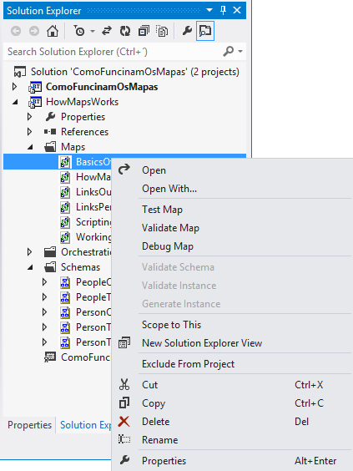
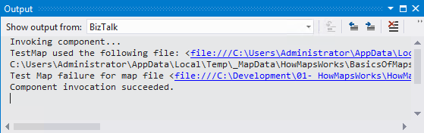
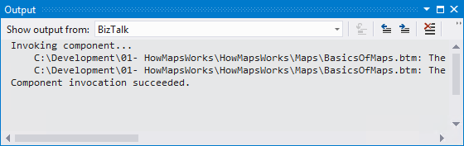
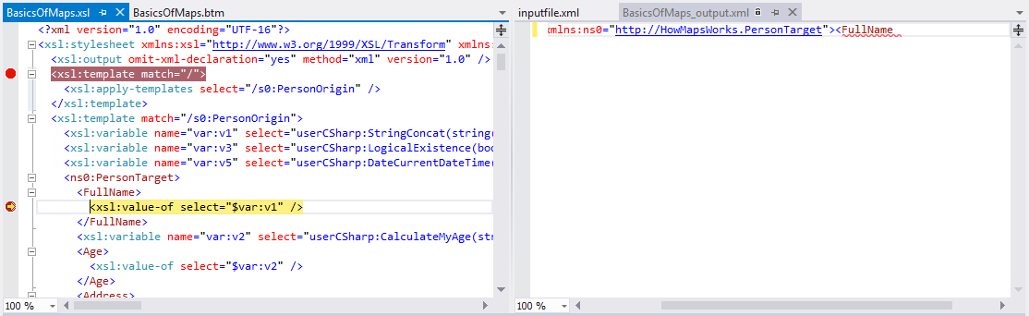
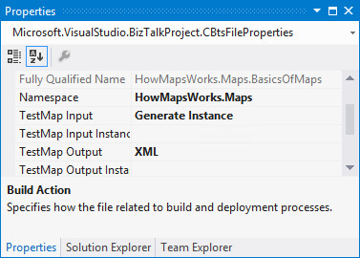
Validating, Testing and Debugging a Map

Slide 12
Data Manipulation with Functoids
Map
Functoids
Use to manipulate mapped data
Can use predefined functoids or create custom functoids
Custom functoids can call scripts
Source Schema
Destination Schema
Record
(..)
Order
PO
PO Number
Status
Date
ItemID
Item No
Qty
Quantity
UnitPrice
X
Order Status
Date
Total Price
Page 1
BizTalk Mapper Extensions UtilityPack: BizTalk Mapper Extensions UtilityPack is a set of libraries with several useful functoids to include and use it in a map, which will provide an extension of BizTalk Mapper capabilities.
http://btsmapextutilitypack.codeplex.com/

Slide 13
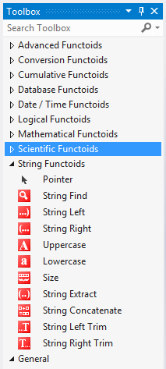
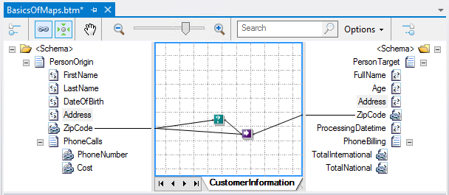

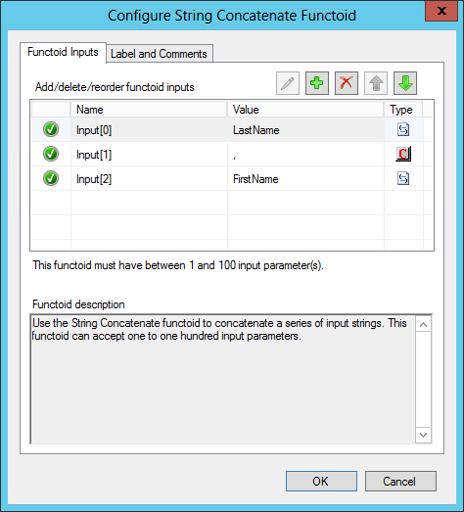
Using Basic Functoids: Adding Functoids to a Map
Link functoids to fields
Drag functoid from Toolbox to map
Configure functoid inputs

Slide 14
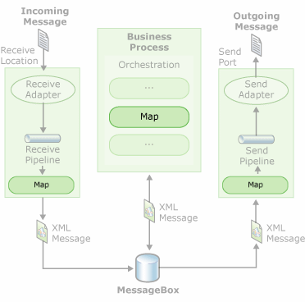
Where can be used?
Maps can be used in
Receive Locations
Send ports
Inside Orchestrations

Slide 15
How BizTalk Mapper Works
How maps are processed internally by the engine of the product as we explore the map editor BizTalk Server.

Slide 16
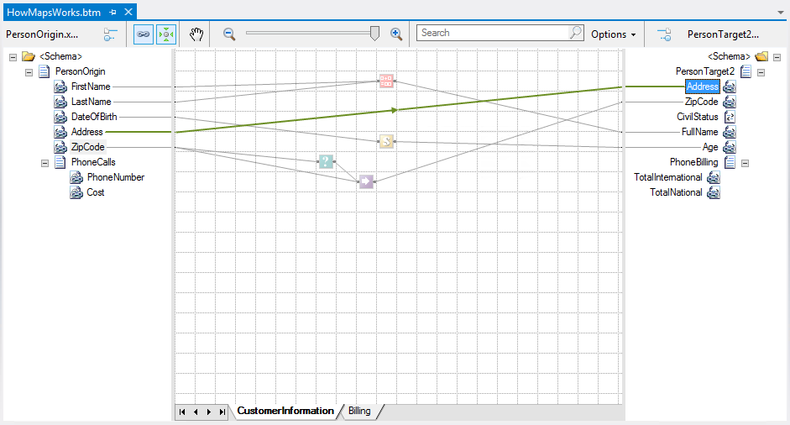
Deconstructing a map
<Address>
<xsl:value-of select="Address/text()" />
</Address>

Slide 17
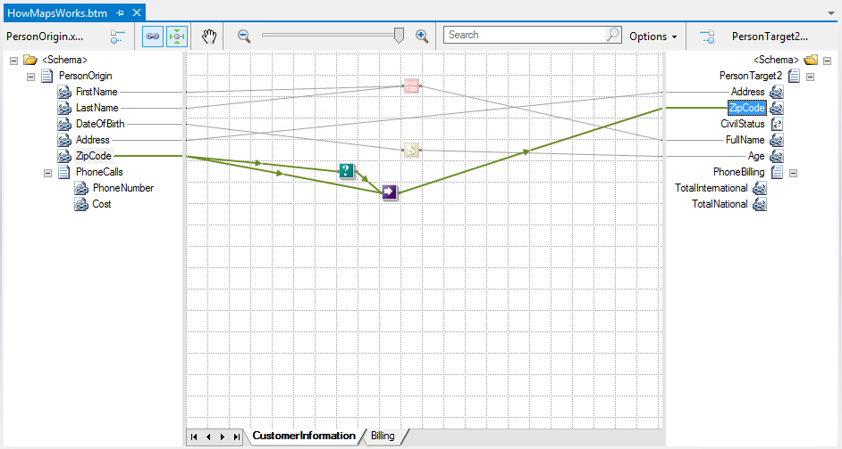
Deconstructing a map
<xsl:variable name="var:v1" select="userCSharp:LogicalExistence(boolean(ZipCode))" />
<xsl:if test="string($var:v1)='true'">
<xsl:variable name="var:v2" select="ZipCode/text()" />
<ZipCode>
<xsl:value-of select="$var:v2" />
</ZipCode>
</xsl:if>

Slide 18
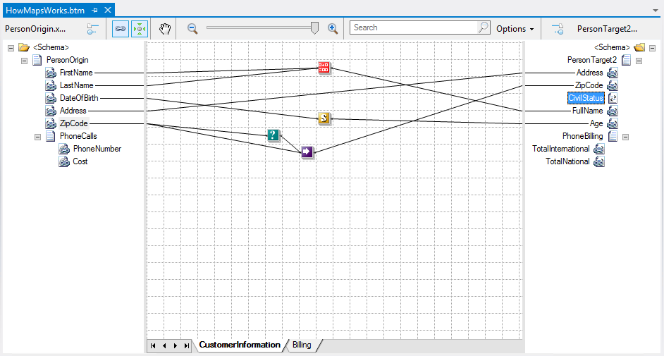
Deconstructing a map

Slide 19
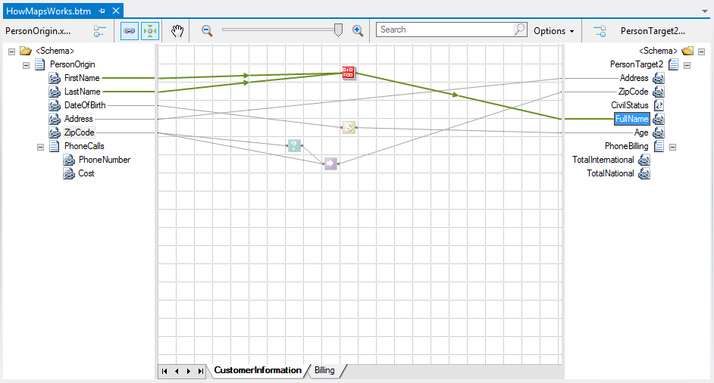
Deconstructing a map
<xsl:variable name="var:v3" select="userCSharp:StringConcat(string(LastName/text()) , ", " , string(FirstName/text()))" />
<FullName>
<xsl:value-of select="$var:v3" />
</FullName>

Slide 20
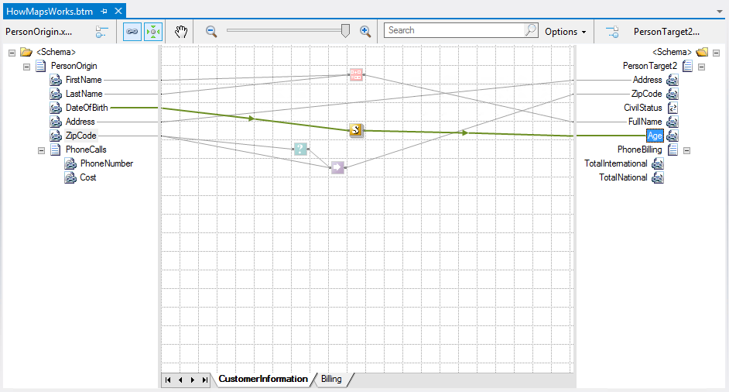
Deconstructing a map
<xsl:variable name="var:v4" select="userCSharp:CalculateMyAge(string(DateOfBirth/text()))" />
<Age>
<xsl:value-of select="$var:v4" />
</Age>

Slide 21
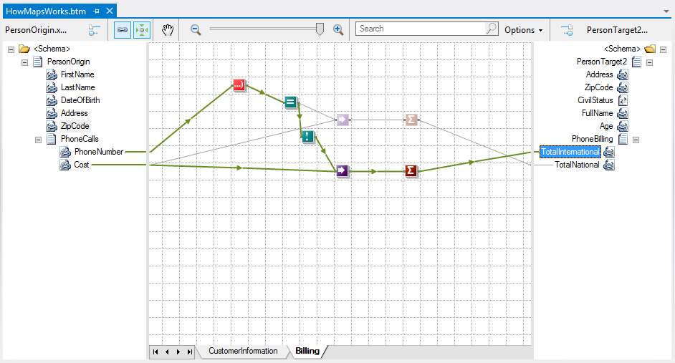
Deconstructing a map
<xsl:variable name="var:v5" select="userCSharp:InitCumulativeSum(0)" />
<xsl:for-each select="/s0:PersonOrigin/PhoneCalls">
<xsl:variable name="var:v6" select="userCSharp:StringLeft(string(@PhoneNumber) , &quot;4&quot;)" />
<xsl:variable name="var:v7" select="userCSharp:LogicalEq(string($var:v6) , &quot;+351&quot;)" />
<xsl:variable name="var:v8" select="userCSharp:LogicalNot(string($var:v7))" />
<xsl:if test="string($var:v8)='true'">
<xsl:variable name="var:v9" select="@Cost" />
<xsl:variable name="var:v10" select="userCSharp:AddToCumulativeSum(0,string($var:v9),&quot;1000&quot;)" />
</xsl:if>
</xsl:for-each>
<xsl:variable name="var:v11" select="userCSharp:GetCumulativeSum(0)" />
<TotalInternational>
<xsl:value-of select="$var:v11" />
</TotalInternational>

Slide 22
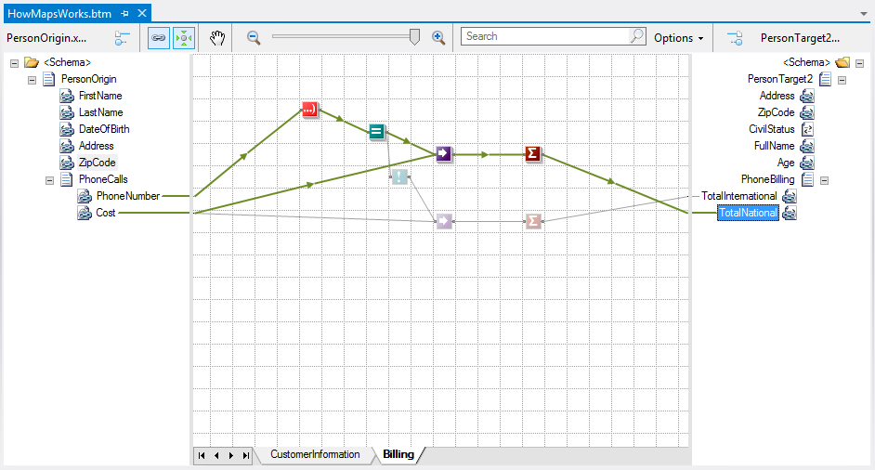
Deconstructing a map
<xsl:variable name="var:v12" select="userCSharp:InitCumulativeSum(1)" />
<xsl:for-each select="/s0:PersonOrigin/PhoneCalls">
<xsl:variable name="var:v13" select="string(@PhoneNumber)" />
<xsl:variable name="var:v14" select="userCSharp:StringLeft($var:v13 , &quot;4&quot;)" />
<xsl:variable name="var:v15" select="userCSharp:LogicalEq(string($var:v14) , &quot;+351&quot;)" />
<xsl:if test="string($var:v15)='true'">
<xsl:variable name="var:v16" select="@Cost" />
<xsl:variable name="var:v17" select="userCSharp:AddToCumulativeSum(1,string($var:v16),&quot;1000&quot;)" />
</xsl:if>
</xsl:for-each>
<xsl:variable name="var:v18" select="userCSharp:GetCumulativeSum(1)" />
<TotalNational>
<xsl:value-of select="$var:v18" />
</TotalNational>

Slide 23
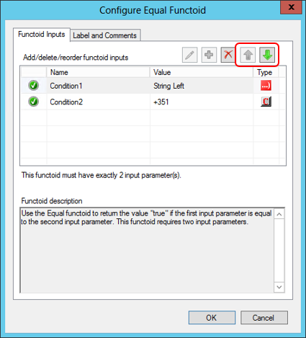
The order of links association
The order in which we perform the links between the elements from source to destination has a huge impact in the final result
This statement is true and false at the same time!
Impact of the order of links in functoids
The functoids require certain input parameters that can vary according to the functoid that we are using

Slide 24
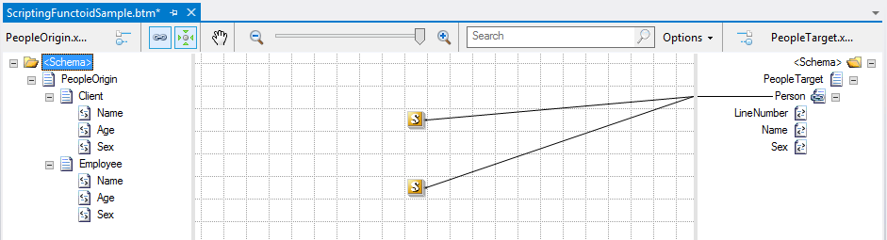
The sequence of links
The order in which we perform the links between the elements from source to destination has a huge impact in the final result
This statement is true and false at the same time!
Impact of the order of links in elements of the destination schema
If we change the order in which we associate the links on the same element in the destination schema we can also have an impact on the desired final result.

Slide 25
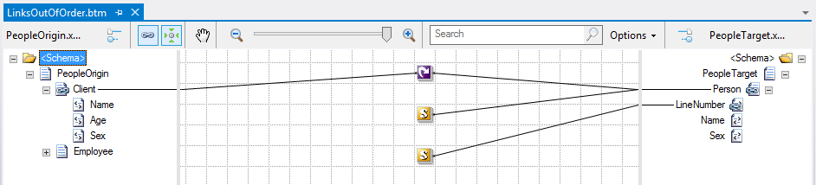
The exception to the rule of Link Sequence
int myCounter = 0;
public void IncrementCounter()
{
myCounter += 1;
}
public int ReturnCounter()
{
return myCounter;
}

Slide 26
Best Practices
What best practices we must implement to improve developing performance

Slide 27
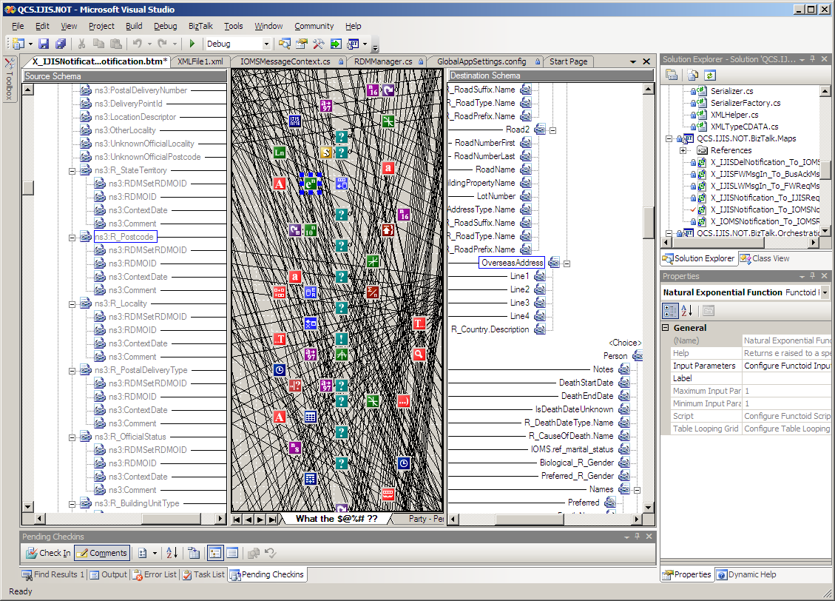
Challenges with large data transformations
Difficult to use with large schemas.
Hard to maintain complex maps
Hard to track relationships
No search capabilities
No cut/copy/paste or undo

Slide 28

Best Practices 1: Using Map Grid Pages
Use pages to reduce complexity of a map
Grid Pages
Grid Preview
Create unlimited different pages
Isolate different parts of a map
Work with different parts of a map separately
Must create connected functoids on the same layer
Source Schema
Destination Schema
Record
(..)
Order
PO
PO Number
Status
Date
ItemID
Item No
Qty
Quantity
UnitPrice
X
Order Status
Date
Total Price
Find and work with a portion of a large map
Page 1
Page 2
Page 3
Page 4

Slide 29
Best Practices 1: Using Map Grid Pages
Pros:
Readability and Maintainability: For new and even for expert developers, or even when working with developers from other teams, using multiple grid pages will make the map easier to read and maintain if necessary make changes
Level of effort: by being easier to read and maintain you will reduce the development time.
Documentation: Using this technique will also help you to make a better map documentation, and sometimes this could be enough to self-documenting the map

Slide 30
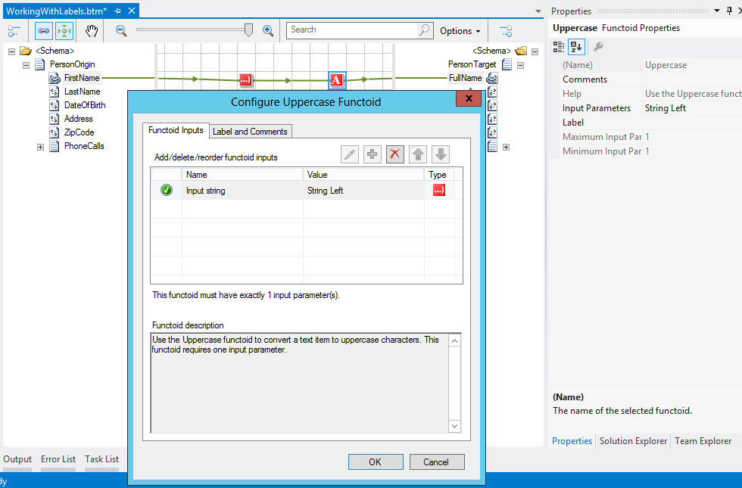
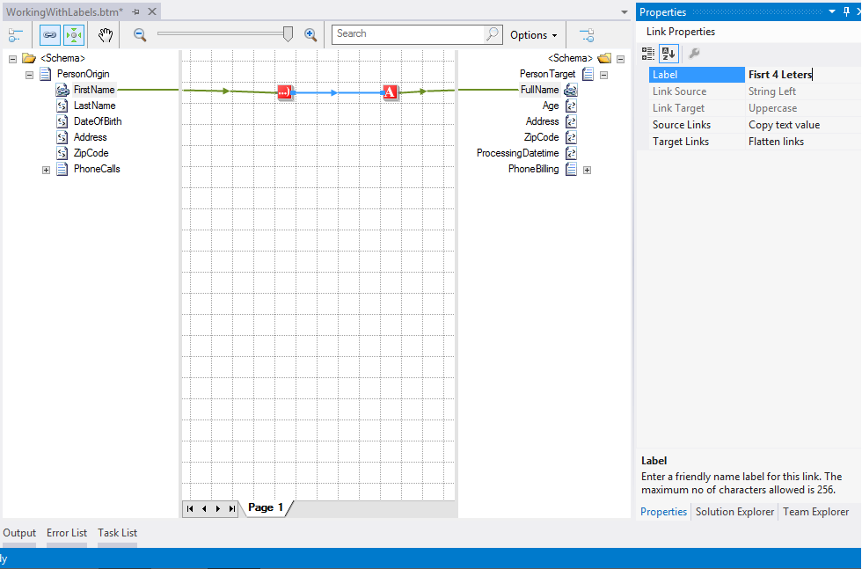
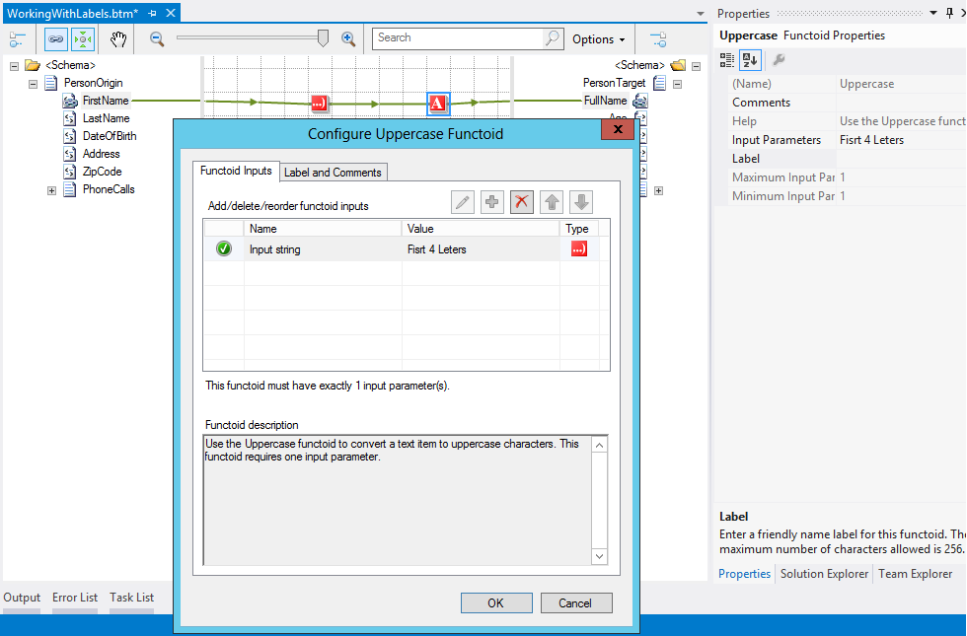
Best Practices 2: Using labels

Slide 31
Best Practices 2: Using labels
Pros:
Readability and Maintainability: For new and even for expert developers, or even when working with developers from other teams, using multiple link labels will make the map easier and faster to read and maintain if necessary to make any changes.
Level of effort: again, by being easier to read and maintain you will reduce the development time.
Documentation: Using this technique will also help you to make a better map documentation

Slide 32
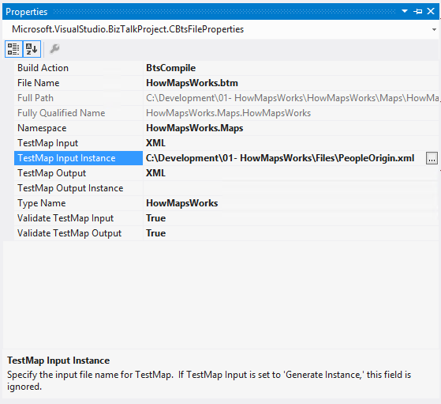
Best Practices 3: Testing should be a continuous process
Testing should be a continuous process as you build your map, not only at the end of development, but when necessary or when an important mapping block is complete

Slide 33
Best Practices 4: Built-in and Custom Functoids vs Scripting Functoid
Scripting Functoid
Allows you to execute custom code
Can execute custom script: C# .NET / VB.NET / JScript.NET / XSLT / XSLT Call Template
But we need to rewrite over and over again!
Reasons to develop custom or use built-in functoids:
They are reusable
More easy to read (visually on the map grid)
Careful: All functoids must have a unique ID in order for the runtime to distinguish them.
The ID is an integer and all IDs below 10000 are reserved for Microsoft use.

Slide 34
Best Practices 4: Built-in and Custom Functoids vs Scripting Functoid
How we can decide what to use:
Can this transformation be reused several times in this map or can be reused in several maps?
Will this transformation cost me several hours of work?
Will this transformation be easier to read and maintain?
Is this approach which that will bring me more profits?

Slide 35
Best Practices 4: Built-in and Custom Functoids vs Scripting Functoid
Basic guidelines to decide what to use:
First guideline: I prefer to use the built-in functoids whenever possible unless is not possible to accomplished or the functoid chain becomes too complex to unravel easily.
Second guideline: I turn to custom scripting functoids, XSLT or C#, only when I cannot solve my problem with the built-in functoids or is too complex to accomplish using built-in functoids.
Third guideline: If is a repeated transformation rule that you can use in several maps you then you should use or create a custom functoid to solve this problem.

Slide 36
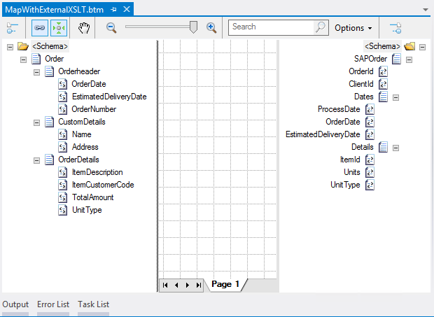
Best Practices 5: External Custom XSLT vs BizTalk Mapper
Pros:
Direct XSLT is more powerful, fewer limitations than the BizTalk Mapper
Improved performance
XSLT file can be developed separately and hosted in a BizTalk map
Cons:
Not quite as intuitive
Functoids are more easy to read (visually on the map grid)
Requires “geeky” coding skills
Loss of visual map representation

Slide 37
Best Practices 6: Reviewing the XSLT
Inspecting the XSLT generated by the compiler provides insight into how the map functions
Also provides another debugging option
In Solution Explorer, right-click *.btm file and select “Validate Map”
Link to generated XSLT shown in Output window

Slide 38
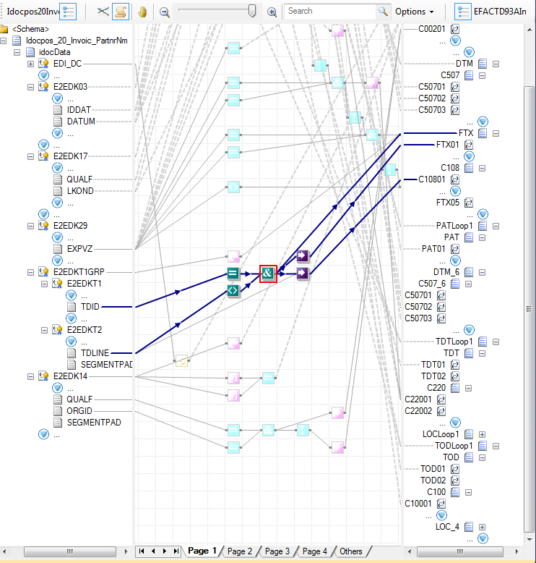
New Mapper in BizTalk Server 2010
Better UI for complex or large transformations
Reduce background “noise” using highlight propagation
Auto-scrolling and sibling coalescing help locate nodes
Enhanced functionality
Support for search
Improved productivity with cut/copy/paste/move/ undo
Predictive match
Improved support for documenting map and readability

Slide 39
BizTalk Server 2013 Improvements
Performance enhancements
The Mapper uses the XSLCompiledTransform class. Previous BizTalk Server versions used the XslTransform class, which is obsolete. The XSLCompiledTransform class provides performance enhancements, including:
Once the Load method completes successfully, the Transform method can be called simultaneously from multiple threads.
The new XSLT processor compiles the XSLT style sheet to a common intermediate format. Once the style sheet is compiled, it can be cached and reused.

Slide 40
Common mapper problems and solutions
Some of the best ways to address some of your needs within the context of message transformation

Slide 41
Custom XSLT
Functoids
Inspect
Labs for tomorrow
BizTalk Mapper Patterns specifying best practices and some of the best ways to address some of your needs within the context of message transformation.
Notes:
02- JoinMultipleMessages
03- HowToSendOrchestrationVariablesIntoMaps
04- WorkingWithConstantValues
05- MappingWorkingWithMultipleOutputMessages
06 – WorkingWithConditions
07- BizTalkMapperIFinLoppingRecord
08- MuenchianGroupingSortingWithoutLosingMapFunctionalitie
10- SandroPereira.MappingToNameValueRecord
11- SandroPereira.NameValueToHierarchical
CommonMappingLogicConstructs

Slide 42
Questions?

Slide 43




Contacts
sandro.pereira@devscope.net
http://pt.linkedin.com/in/sandropereira
@sandro_asp
http://sandroaspbiztalkblog.wordpress.com
www.devscope.net
Bouvet BizTalk Innovation Day 2013

